Slide 1

Somos un ecosistema de desarrolladores de software

Slide 2
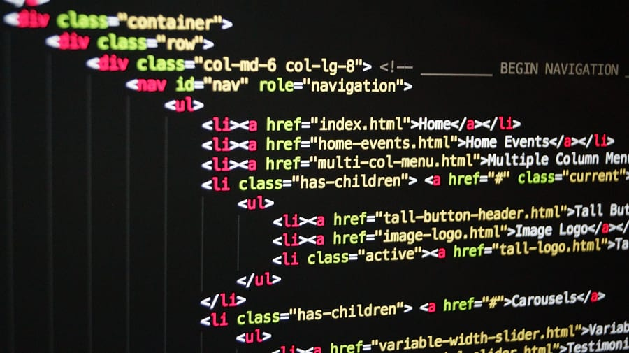


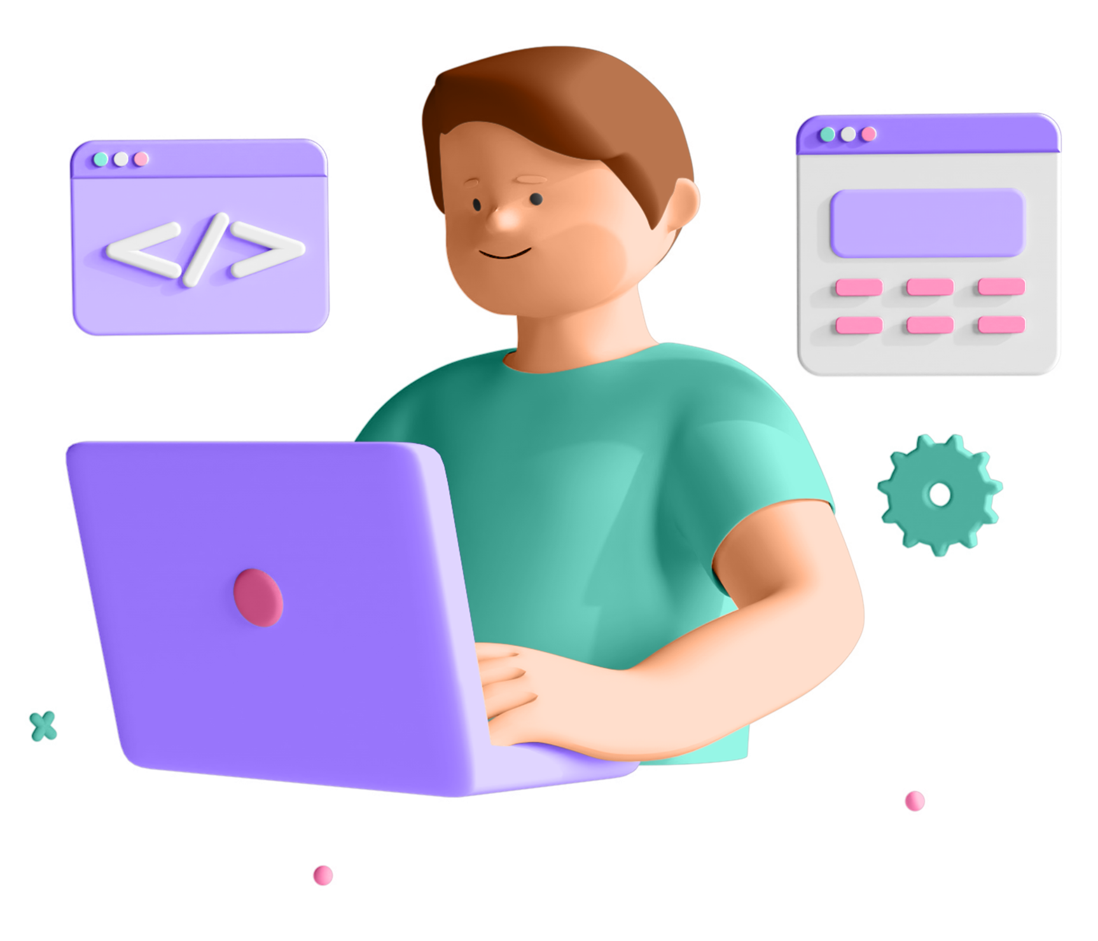

Java Script POO (Document Object Model)

Slide 3

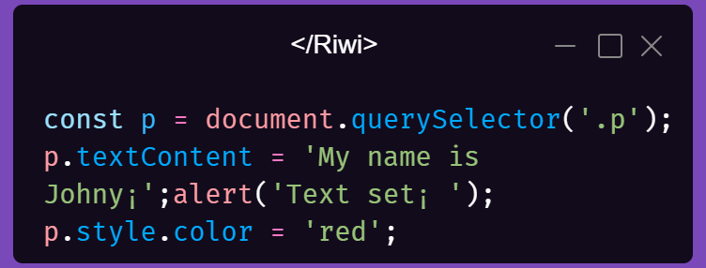
SYNCHRONUS CODE
SYNCHRONUS
❑ Most code is synchronous;
❑ Synchronous code is executed line by line;
❑ Each line of code waits for previous line to finish;
❑Long-running operations block code execution.
BLOCKING

Slide 4

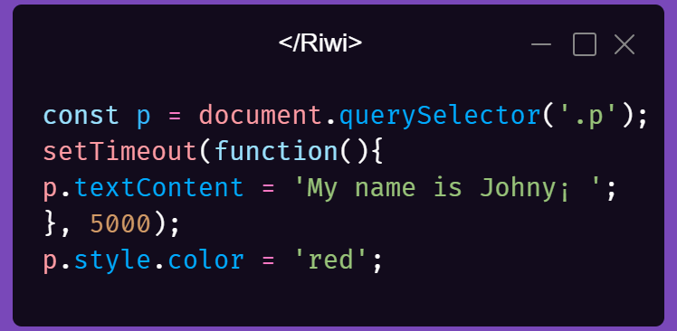
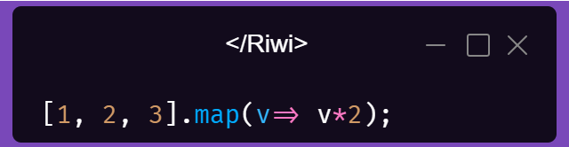
SYNCHRONUS CODE
ASYNCHRONOUS
CALLBACK WILL RUN AFTER TIMER
❑ Asynchronous code is executed after a task that runs in the“background” finishes;
❑ Asynchronous code is non-blocking;
❑ Execution doesn’t wait for an asynchronous task to finish its work;
❑ Callback functions alone do NOT make code asynchronous!
EXECUTED AFTER ALL OTHER CODE
callback does NOT automatically make code asynchronous

Slide 5
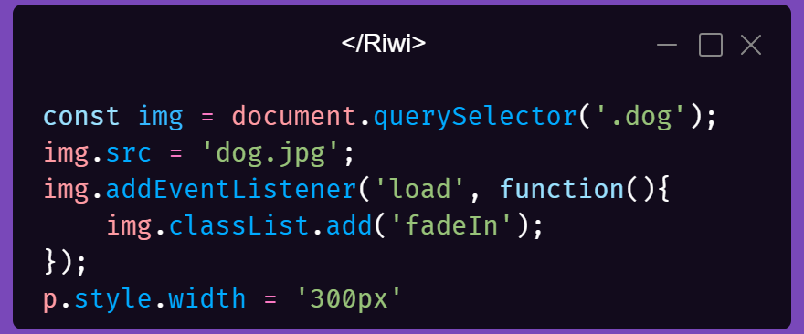
SYNCHRONUS CODE
Asynchronous
CALLBACK WILL RUN AFTER IMAGE LOADS
addEventListener does NOT automatically make code asynchronous¡
❑ Example: Asynchronous image loading with event
and callback Image loading Asynchronous
❑ Other examples: Geolocation API or AJAX calls
➢ Asynchronous code is executed after a task that runs in the “background” finishes;
➢ Asynchronous code is non-blocking;
➢ Execution doesn’t wait for an asynchronous task to finish its work;
➢ Callback functions alone do NOT make code asynchronous!

Slide 6

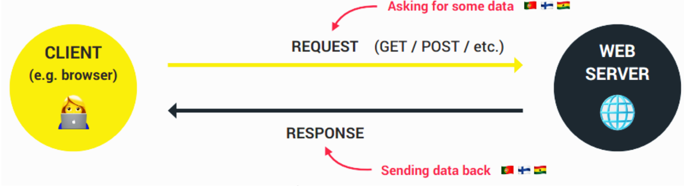
SYNCHRONUS CODE
Asynchronous JavaScript And XML:
Allows us to communicate with remote
web servers in an asynchronous way.
With AJAX calls, we can request data
from web servers dynamically
AJAX
Usually a web API

Slide 7
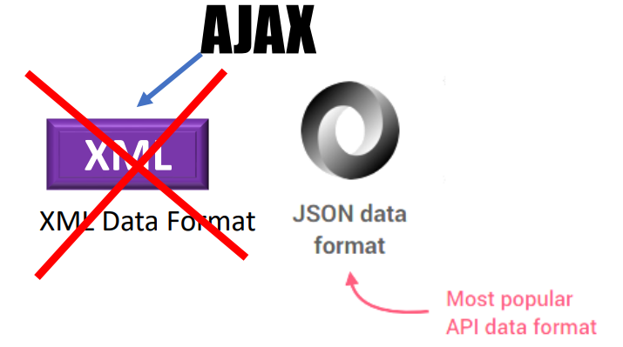
What is a an API?
Application Programming Interface: Piece of software that can be used by another piece of software, in order to allow applications to talk to each other;
✓ There are be many types of APIs in web development:
➢Weather data
➢Data about countries
➢Flights data
➢Currency conversion data
➢APIs for sending email or
SMS
➢Google Maps
➢ Millions of possibilities..
✓ “Online” API: Application running on a server, that receives requests for data, and sends data back as response;
✓ We can build our own web APIs (requires back-end development, e.g. with node.js) or use 3rd-party APIs.
There is an API for everything

Slide 8
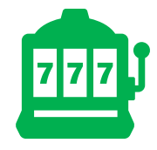
PROMISE
❖ Promise: An object that is used as a placeholder for the future result of an asynchronous operation.
❖ Promise: A container for an asynchronously delivered value.
❖ Promise: A container for a future value.
❖ We no longer need to rely on events and callbacks passed into asynchronous functions to handle asynchronous results;
❖ Instead of nesting callbacks, we can chain promises for a sequence of asynchronous operations: escaping callback hell
Promise that I will receive money if I guess correct outcome.
❑ I buy lottery ticket (promise) right
now
❑ Lottery draw happens
asynchronously
❑ If correct outcome, I receive
money, because it was promised

Slide 9
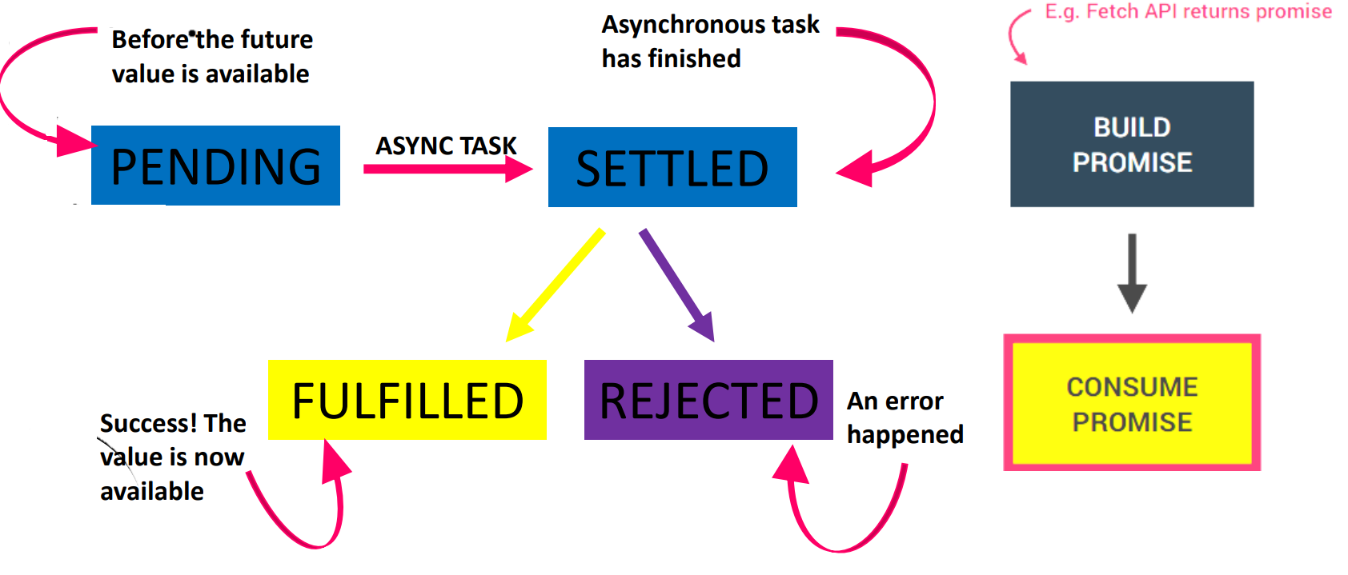
THE PROMISE LIFECYCLE
When we already have a promise. E.g. promise returned from Fetch API
We are able handle these different states in our code!

Slide 10
